Slide 1

JAVA Training
Thomas DECOSTER
Java Senior Consultant
VPTT 2020 4.4.7.4 RC /
<number>

Slide 2
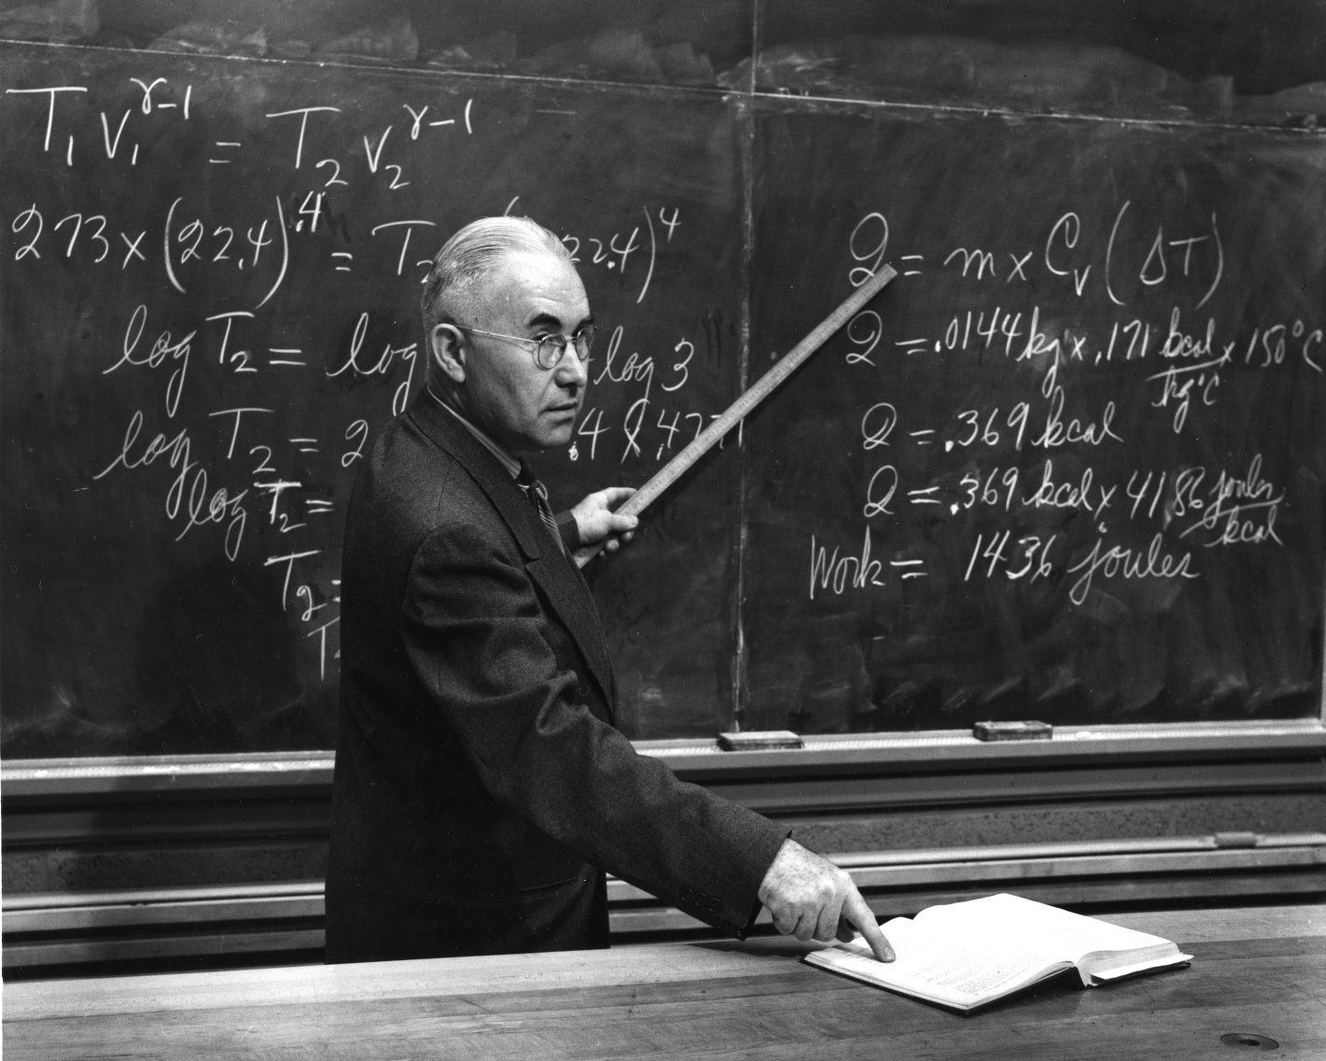

Agenda : Day 1
Introduction : Java Basics
Java Environment
Basic Syntax
VPTT 2020 4.4.7.4 RC /
<number>

Slide 3

Java Basics :
Java Virtual
Machine

Slide 4
Java is compiled AND interpreted
1. A class is defined in a “.java” file that bears its name
“Write once, run everywhere!”*
3. It is executed (or interpreted) by a JVM specific to each platform
1
Java source code
If it is an application
:
fichiers
*.
java
-
java
.
exe
(
Sun
)
Virtual Java
machine
(
Interpreter
)
Win
32
Virtual Java machine in the Web browser
2
Java compiler
Java bytecode
3
fichiers
*.
class
Virtual Java
machine
2. It is compiled in a “.class” bytecode file
(
Interpreter
)
Solaris
-
javac
.
exe
(
Sun
)

Slide 5
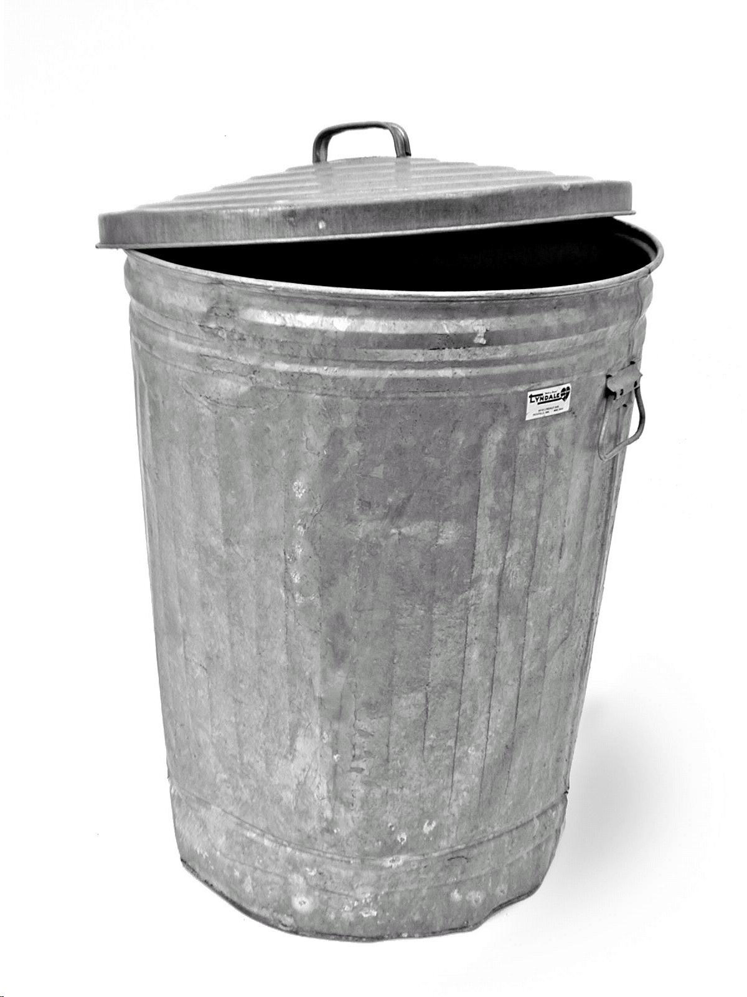
Java Basics :
Garbage Collector
JVM
JVM
JVM
1
2
4
1
2
4
1
2
7
5
7
5
3
3
3
6
6

Slide 6
Garbage Collector.
The Garbage Collector is a robot
Do not play with the GC :
- Do not use System.gc()
- Do not use the method finalize()
Use -Xms / -Xmx to manage memory usage
VPTT 2020 4.4.7.4 RC /
<number>

Slide 7

Java Basics :
Java Environment

Slide 8
JDK.
Includes compiler & runtime environement
this is true for all your
dev environement tools
Multiple Implementations
Choose the same version as your projets uses
Make sure everyone in the team and every environment has the same Java version as the prodution target Java
https://www.oracle.com/fr/java/technologies/javase-downloads.html
https://adoptopenjdk.net/
VPTT 2020 4.4.7.4 RC /
<number>

Slide 9


IDE.
for our training
we will use Intellij
Intellij or Eclipse
VPTT 2020 4.4.7.4 RC /
<number>

Slide 10


Build
& dependency management
for our training
we will use Maven
Maven or Gradle
VPTT 2020 4.4.7.4 RC /
<number>

Slide 11

Application Server.
for our training
we will use Tomcat
Other implementations include : Glassfish, Weblogic, Websphere, JBoss, Jetty
Some can be embeded with Spring boot : Tomcat, Jetty and Undertow
VPTT 2020 4.4.7.4 RC /
<number>

Slide 12

Continuous Integration.
Automated test execution
Automated builds
Automated deployment
VPTT 2020 4.4.7.4 RC /
<number>

Slide 13

Artifact Repository.
VPTT 2020 4.4.7.4 RC /
<number>

Slide 14

Continuous Inspection
& Code Quality.
VPTT 2020 4.4.7.4 RC /
<number>

Slide 15
Run a java program.
# check java version
java -version
# run with .class file
java com.valtech.vitp.HelloValtech arg1 agr2
# run with .jar file
java -jar target/run-java-program-1.0-SNAPSHOT.jar arg1 arg2
VPTT 2020 4.4.7.4 RC /
<number>

Slide 16
Run a java program.
Run as a web application in a web application server
Run as a standalone web application
Run as a service (with a wrapper for windows)
VPTT 2020 4.4.7.4 RC /
<number>

Slide 17
Maven.
pom.xml
modules and multi-modules projects
Dependencies
project structure
Commands
build steps
Plugins
settings.xml
VPTT 2020 4.4.7.4 RC /
<number>

Slide 18
Maven : pom.xml
<?xml version="1.0" encoding="UTF-8"?> <project xmlns="http://maven.apache.org/POM/4.0.0" xmlns:xsi="http://www.w3.org/2001/XMLSchema-instance" xsi:schemaLocation="http://maven.apache.org/POM/4.0.0 http://maven.apache.org/xsd/maven-4.0.0.xsd"> <parent> <artifactId>javatraining</artifactId> <groupId>com.valtech.vitp</groupId> <version>1.0-SNAPSHOT</version> </parent> <modelVersion>4.0.0</modelVersion> <artifactId>run-java-program</artifactId> <packaging>jar</packaging>
<properties> <mockito-core.version>2.28.2</mockito-core.version> <junit.version>4.12</junit.version> </properties>
<dependencies> <dependency> <groupId>junit</groupId> <artifactId>junit</artifactId> <version>${junit.version}</version> <scope>test</scope> </dependency> <dependency> <groupId>org.mockito</groupId> <artifactId>mockito-core</artifactId> <version>${mockito-core.version}</version> <scope>test</scope> </dependency> </dependencies> </project>
VPTT 2020 4.4.7.4 RC /
<number>

Slide 19
Maven : modules
<?xml version="1.0" encoding="UTF-8"?> <project xmlns="http://maven.apache.org/POM/4.0.0" xmlns:xsi="http://www.w3.org/2001/XMLSchema-instance" xsi:schemaLocation="http://maven.apache.org/POM/4.0.0 http://maven.apache.org/xsd/maven-4.0.0.xsd"> <modelVersion>4.0.0</modelVersion> <groupId>com.valtech.vitp</groupId> <artifactId>javatraining</artifactId> <version>1.0-SNAPSHOT</version> <packaging>pom</packaging> <modules> <module>chapter1-run-java-program</module> <module>chapter2-basic-syntax</module> <module>chapter3-test-driven-developement</module> <module>chapter4-web</module> <module>chapter5-advanced</module> <module>chapter6-libraries</module> </modules> <build> <plugins> <plugin> <groupId>org.apache.maven.plugins</groupId> <artifactId>maven-compiler-plugin</artifactId> <version>3.8.0</version> <configuration> <release>11</release> </configuration> </plugin> </plugins> </build> </project>
VPTT 2020 4.4.7.4 RC /
<number>

Slide 20
Maven : dependencies
<dependencies> <dependency> <groupId>org.springframework.boot</groupId> <artifactId>spring-boot-dependencies</artifactId> <version>2.4.3</version> <type>pom</type> <scope>import</scope> </dependency> <dependency> <groupId>org.apache.commons</groupId> <artifactId>commons-lang3</artifactId> <version>3.12.0</version> </dependency> <dependency> <groupId>javax.servlet</groupId> <artifactId>servlet-api</artifactId> <version>2.5</version> <scope>provided</scope> </dependency> <dependency> <groupId>junit</groupId> <artifactId>junit</artifactId> <version>${junit.version}</version> <scope>test</scope> </dependency> <dependency> <groupId>org.mockito</groupId> <artifactId>mockito-core</artifactId> <version>${mockito-core.version}</version> <scope>test</scope> </dependency> </dependencies>
VPTT 2020 4.4.7.4 RC /
<number>

Slide 21
Maven : directory structure
└───maven-project
├───pom.xml
├───src
│ ├───main
│ │ ├───java
│ │ ├───resources
│ │ │ └───META-INF
│ │ └───webapp
│ │ └───WEB-INF
│ │ └───web.xml
│ ├───test
│ │ ├───java
│ │ └───resources
│ ├───it
│ ├───site
│ └───assembly
└───target
├───classes
├───test-classes
├───test-reports
├───generated-sources
├───maven-project-1.0-SNAPSHOT.jar
└───maven-project-1.0-SNAPSHOT.war
VPTT 2020 4.4.7.4 RC /
<number>

Slide 22
Maven : build phases
phase(s) | operations
validate | checks all pom.xml
initialize | initialize properties and directories
generate-sources + process-sources | if needed prepares source code
compile | compile the source code of the project
generate-test-sources + process-test-sources + generate-test-resources + process-test-resources + test-compile | same operations for test directory
test | run tests
package | prepares the final artifact (jar or war)
integration-test +verify | runs integration tests
install | put the package into the local repository
deploy | put the package in a distant shared repository for publishing
VPTT 2020 4.4.7.4 RC /
<number>

Slide 23
Maven : commands
// the command used all day long
mvn clean install
// sometimes you don’t want to run unit tests...
mvn clean install -DskipTests
// to run integration tests
mvn clean verify
// deploy on the shared repo (most of the time run by jenkins)
mvn clean deploy
// useful to resolve dependency problems
mvn dependency:tree -Dverbose -Dincludes=commons-collections
VPTT 2020 4.4.7.4 RC /
<number>

Slide 24
Maven : plugins
<plugin> <groupId>com.sun.xml.ws</groupId> <artifactId>jaxws-maven-plugin</artifactId> <version>2.3.2</version> <executions> <execution> <id>generate-java-sources</id> <phase>process-sources</phase> <goals> <goal>wsimport</goal> </goals> <configuration> <extension>true</extension> <wsdlLocation>https://www.w3schools.com/xml/tempconvert.asmx?WSDL</wsdlLocation> <wsdlLocation>/wsdl/MyService.wsdl</wsdlLocation> </configuration> </execution> </executions> <dependencies> <dependency> <groupId>javax.xml.bind</groupId> <artifactId>jaxb-api</artifactId> <version>2.3.1</version> </dependency> <dependency> <groupId>javax.xml.ws</groupId> <artifactId>jaxws-api</artifactId> <version>2.3.1</version> </dependency> </dependencies> </plugin>
VPTT 2020 4.4.7.4 RC /
<number>

Slide 25
Maven : settings.xml
<settings>
...
<localRepository>${user.home}/.m2/repository</localRepository>
...
<mirrors>
<mirror>
<id>internal-repository</id>
<name>Maven Repository Manager running on repo.mycompany.com</name>
<url>http://repo.mycompany.com/proxy</url>
<mirrorOf>*</mirrorOf>
</mirror>
</mirrors>
...
<proxies>
<proxy>
<id>example-proxy</id>
<active>true</active>
<protocol>http</protocol>
<host>proxy.example.com</host>
<port>8080</port>
<username>proxyuser</username>
<password>somepassword</password>
<nonProxyHosts>www.google.com|*.example.com</nonProxyHosts>
</proxy>
</proxies>
...
</settings>
VPTT 2020 4.4.7.4 RC /
<number>

Slide 26
GIT Workflow.
Find the right branch
git pull --rebase
git branch -a
not found
Create a new remote branch
git checkout -b branch_name
git push -u origin/branch_name
found
Checkout branch
git checkout --track -b branch_name origin/branch_name
Work
git add -A
git commit -m”message”
Check locally
git pull --rebase
mvn clean install
Push
git push
VPTT 2020 4.4.7.4 RC /
<number>

Slide 27






GIT Workflow.
Check Jenkins build is OK
Use your eyes
Create a pull request
Someone else validates your pull request
Merge in master
git checkout target_branch_name
git merge branch_name
git push
Back in master
git checkout master
Go back to first step !
VPTT 2020 4.4.7.4 RC /
<number>

Slide 28
GIT - Useful aliases.
Add those aliases and functions to your ~/.bash-profile :
## maven ##
alias mci='mvn clean install'
alias mcist='mvn clean install -DskipTests'
## git ##
alias gpr='git pull --rebase'
alias gs='git status'
alias gaa='git add -A'
alias gk='gitk --all&'
alias gp='git push'
alias gba='git branch -a'
# new remote branch
function gnrb {
if [ "$#" -ne 1 ]; then
echo "Usage : gnrb branch_name"
else
git checkout -b $1
git push -u origin/$1
fi
}
# checkout remote branch
function grco {
if [ "$#" -ne 1 ]; then
echo "Usage : grco branch_name"
else
git checkout --track -b $1 origin/$1
fi
}
VPTT 2020 4.4.7.4 RC /
<number>

Slide 29

Java Basics :
Basic Syntax

Slide 30
Primitive Types.
boolean b = true; int i = 1; long l = 2l; float f = 2.0f; double d = 3.0; // char : used to handle Strings // byte : used to handle I/O streams // short is never used Boolean b2 = true; Integer i2 = 1; Long l2 = 2l; Float f2 = 2.0f; Double d2 = 2.0; BigDecimal bd = new BigDecimal(0);
VPTT 2020 4.4.7.4 RC /
<number>

Slide 31
Strings.
private final String CONSTANT_STRING = "A simple String sample : %s - %f"; private String buildString(String src) { StringBuilder sb = new StringBuilder(src).append("and ").append("more ").append("numbers "); for (int i = 0; i < 10; i++) { sb.append(i); } return sb.toString(); } CONSTANT_STRING, // A simple String sample : %s - %f CONSTANT_STRING.replace('e', '\u01B1'), // A simplƱ String samplƱ : %s - %f String.format(CONSTANT_STRING, "toto", 28.32f), // A simple String sample : toto - 28,320000 CONSTANT_STRING.toUpperCase(), // SIMPLE STRING SAMPLE : %S - %F buildString(CONSTANT_STRING), // A simple String sample : %s - %fand more numbers 0123456789 Pattern.compile("[aeiou]").matcher(CONSTANT_STRING).replaceAll("*"), // A s*mpl* Str*ng s*mpl* : %s - %f CONSTANT_STRING.replaceAll("[aeiou]","#") // A s#mpl# Str#ng s#mpl# : %s - %f
VPTT 2020 4.4.7.4 RC /
<number>

Slide 32
Objects, attributes and methods.
public class ValtechTalentProgram { private int count; public int getCount() { return count; } public void setCount(int count) { this.count = count; } @Override public String toString() { return "ValtechTalentProgram (count="+count+")"; } @Override public boolean equals(Object o) { if (this == o) return true; if (o == null || getClass() != o.getClass()) return false; ValtechTalentProgram that = (ValtechTalentProgram) o; return count == that.count; } @Override public int hashCode() { return Objects.hash(count); }
//protected void finalize() throws Throwable { } }
VPTT 2020 4.4.7.4 RC /
<number>

Slide 33
Naming conventions.
CamelCase : ValtechTalentProgram
snakeCase : valtech_talent_program
kebab-case : valtech-talent-program
packages are lower case : com.valtech.talent.program
class names are camelCase : ValtechTalentProgram
variables and methods are lowerCamelCase : userName getUserName()
constants are UPPER_SNAKE_CASE : MAX_PARAMETER_SIZE
use nouns for variables and verbs for methods
use coding conventions from your project !
Intellij autoformat : Ctrl + Alt + L
VPTT 2020 4.4.7.4 RC /
<number>

Slide 34
Packages.
declare with :
package com.valtech.talent.program;
Use with :
import java.util.ArrayList;
import java.util.*;
import static java.util.ArrayList.of;
import static java.util.ArrayList.*;
Package by feature not by layer
VPTT 2020 4.4.7.4 RC /
<number>

Slide 35
Visibility & keywords.
public : accessible by any other class
protected : accessible in the same package and subclasses
private : only accessible within the declared class
static : methods/attributes owned by the class, not the instance, can be accessed without creating an object
final : makes attributes and methods non-changeable (impossible to inherit or override)
abstract : An abstract class cannot be used to create objects, an abstract method does not have a body. The body is provided by the subclass
this : Refers to the current object in a method or constructor
super : Refers to superclass (parent) objects
VPTT 2020 4.4.7.4 RC /
<number>

Slide 36
Control structures.
private enum Sample {A, B, C, D}
boolean condition = true, condition2 = true, condition3 = true; while ( condition ) { // ... do something } for (int i = 0 ; i < 10; i++ ) { // ... do something } if (condition2) { // ... do something } else if (condition3) { // ... do something } else { // ... do something } Sample expression = condition ? Sample.B : Sample.C; switch (expression) { case A : // ... do something for A break; case B : case C : // ... do something for B or C break; default : // ... do something for anything else }
VPTT 2020 4.4.7.4 RC /
<number>

Slide 37
Polymorphism : inheritance.
public abstract class Transport { abstract void move(); } public class Car extends Transport { @Override void move() { System.out.println("drive"); } } public class Plane extends Transport { @Override void move() { System.out.println("fly"); } } public class Bike extends Transport { @Override void move() { System.out.println("ride"); } }
VPTT 2020 4.4.7.4 RC /
<number>

Slide 38
Polymorphism : interfaces.
public interface EnergySource { void refill(); } public interface GasPowered extends EnergySource{ default void refillTank() { System.out.println("Fill gas tank"); } } public interface ElectricPowered extends EnergySource{ default void refillBattery() { System.out.println("Fill batteries"); } } public class GasPoweredCar extends Car implements GasPowered { public void refill(){ this.refillTank(); } } public class ElectricCar extends Car implements ElectricPowered { public void refill(){ this.refillBattery(); } } public class ElectricBike extends Bike implements ElectricPowered { public void refill(){ this.refillBattery(); } }
VPTT 2020 4.4.7.4 RC /
<number>

Slide 39
Error handling.
public class ActionImpossibleException extends Exception { public ActionImpossibleException(String message){ super(message); } } public void doSomething(int amount) throws ActionImpossibleException { if(amount < 0){ throw new IllegalArgumentException("Amount must be positive"); } if(amount > 1000){ throw new ActionImpossibleException("amount over limit"); } } public static void main(String[] args) { ExceptionsSample exceptionsSample = new ExceptionsSample(); System.out.println(4 / 0); try { exceptionsSample.doSomething(20000); } catch (ArithmeticException | ActionImpossibleException ex) { // handle exception here ex.printStackTrace(); throw new RuntimeException(ex);
} finally { // free resources } }
VPTT 2020 4.4.7.4 RC /
<number>

Slide 40
Outdated APIs.
@deprecated
Threadsafe vs non Threadsafe
java.util.Date => java.time.LocalDate
Rich Clients( AWT, Swing)
jsp jstl jsf
VPTT 2020 4.4.7.4 RC /
<number>

Slide 41

Thank You
Presenter Name, Presenter Title
Email Phone Number
VPTT 2020 4.4.7.4 RC /
<number>

Slide 42
VPTT 2020 4.4.7.4 RC /
<number>
Notes:
<number>

